Slide 1
The Nyquist Criterion
A Frequency Response Analysis Technique

Slide 2
Nyquist Plot or Polar Plot
Nyquist Plots were invented by Nyquist - who worked at Bell Laboratories, the premiere technical organization in the U.S. at the time.
Nyquist Plots are a way of showing frequency responses of linear systems.
A Nyquist plot is a polar plot of the frequency response function of a linear system.
Nyquist plots display both amplitude and phase angle on a single plot, using frequency as a parameter in the plot.
Nyquist plots have properties that allow you to see whether a system is stable or unstable.

Slide 3
Nyquist Plot
That means a Nyquist plot is a plot of the transfer function, G(s) with s = jω. That means you want to plot G(j ω).
G(j ω) is a complex number for any angular frequency, ω, so the plot is a plot of complex numbers.
The complex number, G(j ω), depends upon frequency, so frequency will be a parameter if you plot the imaginary part of G(j ω) against the real part of G(j ω).

Slide 4
Sketch the Polar plot of Frequency Response
To sketch the polar plot of G(jω) for the entire range of frequency ω, i.e., from 0 to infinity, there are four key points that usually need to be known:
The start of plot where ω = 0,
The end of plot where ω = ∞,
Where the plot crosses the real axis, i.e., Im(G(jω)) = 0, and
Where the plot crosses the imaginary axis, i.e., Re(G(jω)) = 0.

Slide 5



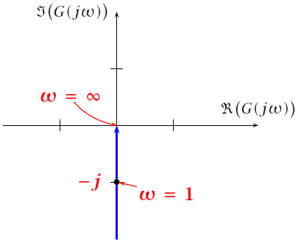
Problem-1: Polar Plot of Integrator
Consider a first order system,
Representing G(s) in the frequency response form G( jω ) by replacing s = jω:
The magnitude of G( jω ), i.e., | G( jω) |, is obtained as;
The phase of G( jω ), denoted by, φ , is obtained as;
Polar Plot

Slide 6




Problem-2: Polar Plot of First Order System
Consider a first order system
where T is the time constant.
Representing G(s) in the frequency response form G( jω ) by replacing s = jω:
The magnitude of G( jω ), i.e., | G( jω) |, is obtained as;
The phase of G( jω ), denoted by, φ , is obtained as;

Slide 7



The start of plot where ω = 0
The end of plot where ω = ∞
The mid part of plot where ω = 1/T

Slide 8
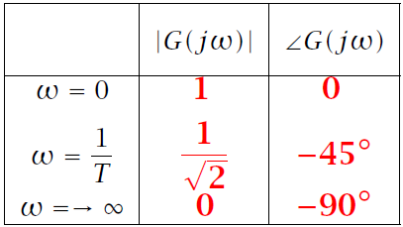
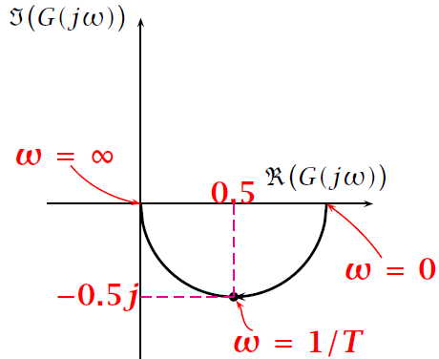
Polar Plot

Slide 9



Problem-3: Polar Plot of Second Order System
Consider a second order system
where T is the time constant.
Representing G(s) in the frequency response form G( jω ) by replacing s = jω:
The magnitude of G( jω ), i.e., | G( jω) |, is obtained as;
The phase of G( jω ), denoted by, φ , is obtained as;

Slide 10
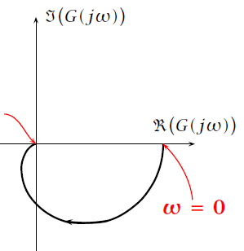
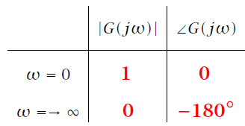
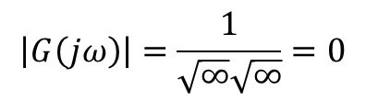

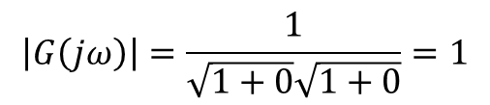
The start of plot where ω = 0
$$\left|G\left(jω\right)\right|=\frac{1}{\sqrt{1+0}\sqrt{1+0}}=1$$
$$∠G\left(jω\right)=−\tan^{−1}\left(0\right)−\tan^{−1}\left(0\right)=0°$$
The end of plot where ω = ∞
$$\left|G\left(jω\right)\right|=\frac{1}{\sqrt{∞}\sqrt{∞}}=0$$
$$∠G\left(jω\right)=−\tan^{−1}\left(∞\right)−\tan^{−1}\left(∞\right)=−90°−90°=−180°$$
Polar Plot

Slide 11
Four Important Points for Derivation the Nyquist Criterion
The relationship between the poles of 1 + G(s)H(s) and the poles of G(s)H(s);
The relationship between the zeros of 1 + G(s)H(s) and the poles of the closed-loop transfer function, T(s);
The concept of mapping points;
The concept of mapping contours.

Slide 12
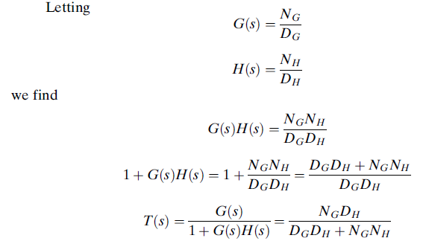
It is conclude that;
The poles of 1 + G(s)H(s) are the same as the poles of G(s)H(s), the open-loop system.
The zeros of 1 + G(s)H(s) are the same as the poles of T(s), the closed-loop system.

Slide 13
The Concept of Mapping
If we take a complex number s = x+jy on the s-plane and substitute it into a function, F(s), another complex number results. This process is called mapping.
OR
The term mapping is defined as the substitution of a complex number into a function, F(s), to get another complex number.
For example, substituting s = 4 + j3 into the function F(s) = (s² +2s + 1) yields 16+j30. We say that 4 + j3 maps into 16+j30 through the function s² +2s + 1.

Slide 14
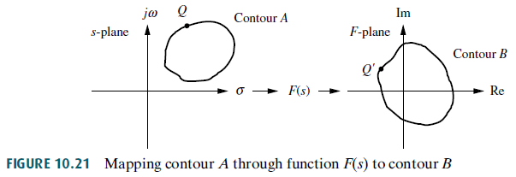

The Concept of Mapping Contours
The collection of points, called a contour.

Slide 15
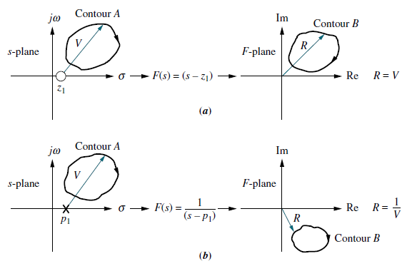
Examples of Contour Mapping
If we assume a clockwise direction for mapping the points on contour A, the contour B maps a clockwise direction if F(s) has just zeros or has just poles that are not encircled by the contour.

Slide 16
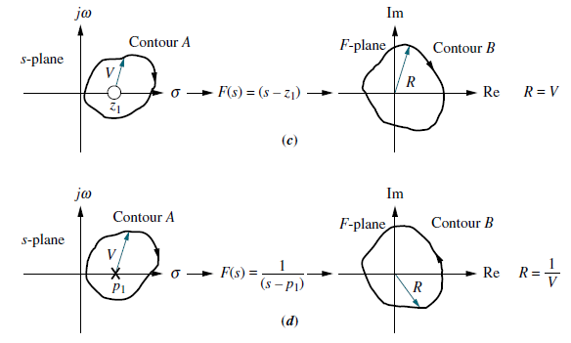
Examples of Contour Mapping
The contour B maps in a counter clockwise direction if F(s) has just poles that are encircled by the contour, Also, you should verify that, if the pole or zero of F(s) is enclosed by contour A, the mapping encircles the origin .

Slide 17
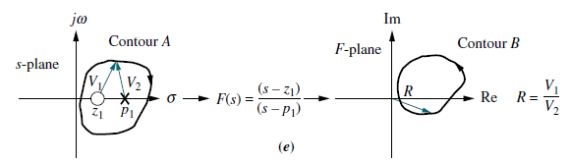
Examples of Contour Mapping
In this last case, the pole and zero rotation cancel, and the mapping does not encircle the origin.

Slide 18
THE NYQUIST STABILITY CRITERION
A linear closed-loop continuous control system is absolutely stable if the roots of the characteristic equation have negative real parts.
Equivalently, the poles of the closed-loop transfer function, or the zeros of the denominator, 1 + GH(s), of the closed-loop transfer function, must lie in the left-half plane.
The Nyquist Stability Criterion establishes the number of zeros of 1 + GH(s) in the right-half plane directly from the Nyquist Stability Plot of GH(s).

Slide 32


Nyquist Stability Criterion
The closed-loop control system whose open-loop transfer function is GH is stable if and only if
Where,
N = total number of CW encirclements of the (-1,0) point (i.e., GH = - 1 ) in the GH-plane.
P_{o} = number of poles of GH in the right-hand-plane RHP for continuous systems.
If N > 0, the number of zeros Z_{o} of 1 + GH in the RHP for continuous systems, is determined by
If N ≤ 0 and P_{o} = 0, then the system is absolutely stable if and only if N = 0; that is, if and only if the (-1,0) point does not lie in the shaded region.

Slide 33



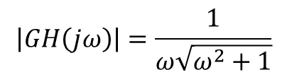
Problem-7: Sketch the polar plot for the following transfer function and check the stability of the system.
There is one pole at the origin.
Representing G(s)H(s) in the frequency response form G( jω )H(jω) by replacing s = jω:
The magnitude of GH(jω) i.e., |GH(jω)|, is obtained as;
$$\left|GH\left(jω\right)\right|=\frac{1}{ω\sqrt{ω^{2}+1}}$$
The phase of GH(jω) denoted by, $φ$, is obtained as;
$$φ=∠GH\left(0\right)=−90°−\tan^{−1}\left(\frac{ω}{1}\right)$$

Slide 34
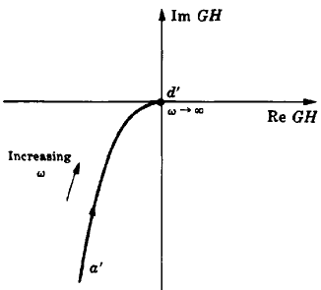
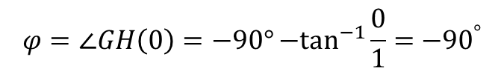
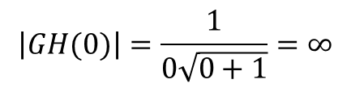
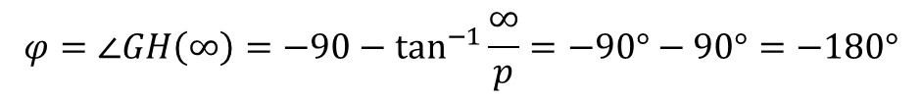
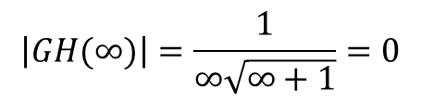
Point 1: The start of plot where ω = 0
$$\left|GH(0)\right|=\frac{1}{0\sqrt{0+1}}=∞$$
$$φ=∠GH\left(0\right)=−90°{−tan}^{−1}{\frac{0}{1}=}{−90}^{°}$$
Point 2: The end of plot where ω = ∞
$$\left|GH(∞)\right|=\frac{1}{∞\sqrt{∞+1}}=0$$
$$φ=∠GH\left(∞\right)={−90−tan}^{−1}{\frac{∞}{p}=−90°}−90°=−180°$$
Polar Plot
 | |GH(jω)| | ∠GH(jω)
ω = 0 | ∞ | -90º
ω = ∞ | 0 | -180º

Slide 40
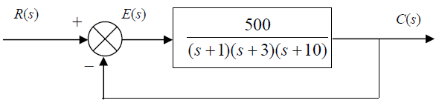
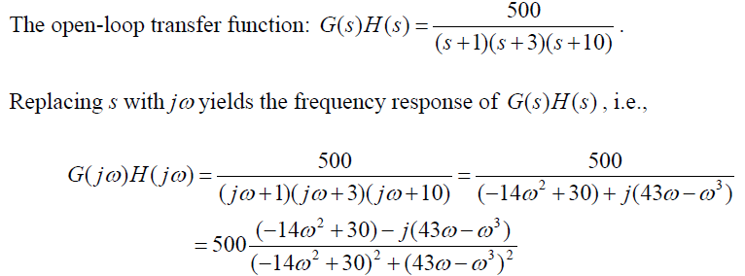
Problem-4: Sketch the Nyquist diagram for the system shown in the following figure, and then determine the system stability using the Nyquist criterion.
(a)

Slide 41
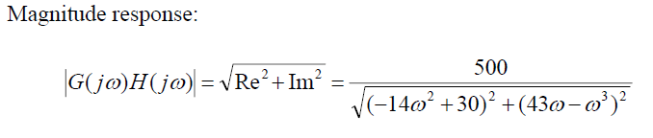
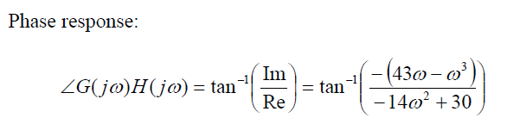
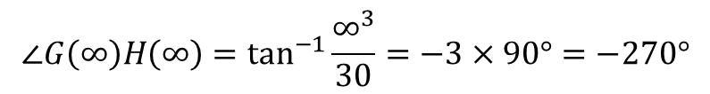
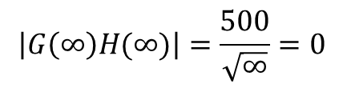
Now that we have expressions for the magnitude and phase of the frequency response, we can sketch the polar plot using the 4 key points.
Point 1: The start of plot where ω = ∞
$$\left|G\left(∞\right)H(∞)\right|=\frac{500}{\sqrt{∞}}=0$$
$$∠G\left(∞\right)H\left(∞\right)=\tan^{−1}{\frac{∞^{3}}{30}=−3×90°=−270°}$$

Slide 42
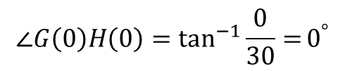
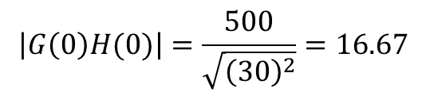
Point 2: The end of plot where ω = 0
$$\left|G\left(0\right)H(0)\right|=\frac{500}{\sqrt{{\left(30\right)}^{2}}}=16.67$$
$$∠G\left(0\right)H\left(0\right)=\tan^{−1}{\frac{0}{30}=}0^{°}$$
Point 3: Where the plot crosses the real axis, i.e., Im(G(jω)) = 0
Take the imaginary part of equation (a), and put equal to zero, to get the value of frequency ω at the interception of real axis.

Slide 43
Point 4: Where the plot crosses the imaginary axis, Re(G(jω)) = 0
Take the real part of equation (a), and put equal to zero, to get the value of frequency ω at the interception of imaginary axis.

Slide 61
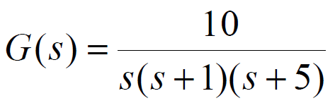
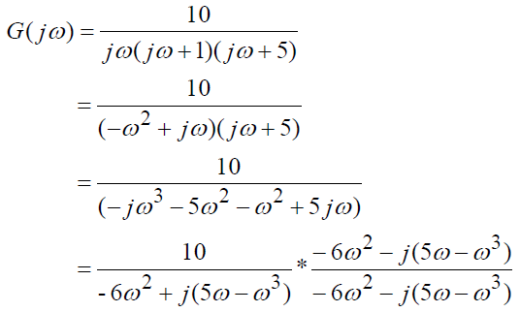

Problem-5: Sketch the polar plot for the following transfer function.
Representing G(s) in the frequency response form G( jω ) by replacing s = jω, and then Multiply both numerator and denominator by the conjugate of denominator.
(a)

Slide 62




Point 1: The start of plot where ω = 0
At frequency ω = 0, we only observe the most significant terms that take the effect.
Magnitude at ω = 0:
Phase at ω = 0:
Point 2: The end of plot where ω = ∞
At frequency ω = ∞, we shall look at the most significant term that takes effect when the frequency approaches infinity.
Magnitude at ω = ∞:
Phase at ω = ∞:

Slide 63
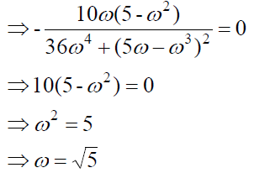

Point 3: Where the plot crosses the real axis, i.e., Im(G(jω)) = 0
Take the imaginary part of equation (a), and put equal to zero, to get the value of frequency ω at the interception of real axis.
Therefore, the intersection point between the polar plot and the real axis, when $ω=\sqrt{5,}$ is located at;

Slide 64
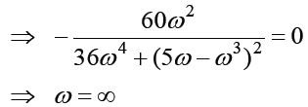

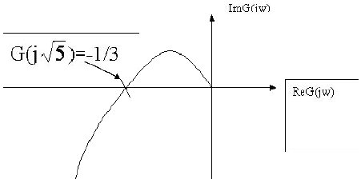
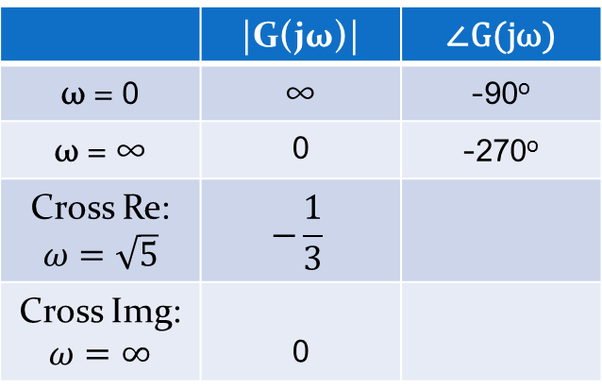
Point 4: Where the plot crosses the imaginary axis, Re(G(jω)) = 0
Take the real part of equation (a), and put equal to zero, to get the value of frequency ω at the interception of imaginary axis.
Therefore, the intersection point between the polar plot and the imaginary axis is when $ω=∞$ is located at;
Polar Plot
 | |G(jω)| | ∠G(jω)
ω = 0 | ∞ | -90º
ω = ∞ | 0 | -270º
Cross Re: $ω=\sqrt{5}$ | $$−\frac{1}{3}$$
Cross Img: $ω=∞$ | 0

Slide 65


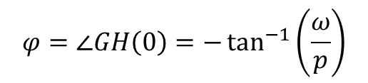
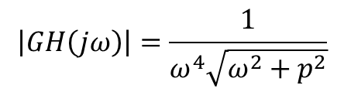
Problem-6: Sketch the polar plot for the following transfer function.
Representing G(s)H(s) in the frequency response form G( jω )H(jω) by replacing s = jω:
The magnitude of GH(jω) i.e., |GH(jω)|, is obtained as;
$$\left|GH\left(jω\right)\right|=\frac{1}{ω^{4}\sqrt{ω^{2}+p^{2}}}$$
The phase of GH(jω) denoted by, $φ$, is obtained as;
$$φ=∠GH\left(0\right)=−\tan^{−1}\left(\frac{ω}{p}\right)$$

Slide 66
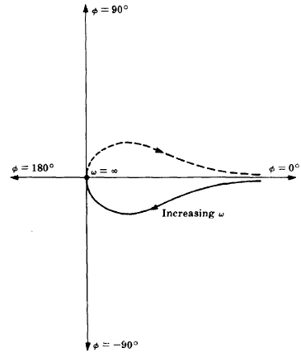
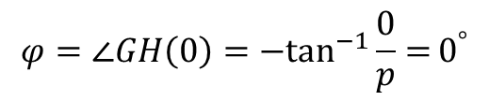
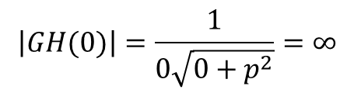
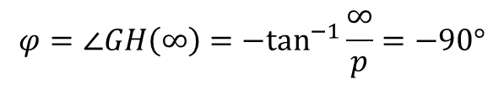
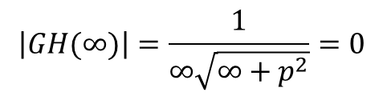
Point 1: The start of plot where ω = 0
$$\left|GH(0)\right|=\frac{1}{0\sqrt{0+p^{2}}}=∞$$
$$φ=∠GH\left(0\right)={−tan}^{−1}{\frac{0}{p}=}0^{°}$$
Point 2: The end of plot where ω = ∞
$$\left|GH(∞)\right|=\frac{1}{∞\sqrt{∞+p^{2}}}=0$$
$$φ=∠GH\left(∞\right)={−tan}^{−1}{\frac{∞}{p}=−90°}$$
Polar Plot
 | |GH(jω)| | ∠GH(jω)
ω = 0 | ∞ | 0º
ω = ∞ | 0 | -90º

Slide 67
Problem-7: Sketch the polar plot for the following transfer function and check the stability of the system.
There is one pole at the origin.
Representing G(s)H(s) in the frequency response form G( jω )H(jω) by replacing s = jω:
The magnitude of GH(jω) i.e., |GH(jω)|, is obtained as;
$$\left|GH\left(jω\right)\right|=\frac{1}{ω\sqrt{ω^{2}+1}}$$
The phase of GH(jω) denoted by, $φ$, is obtained as;
$$φ=∠GH\left(0\right)=−90°−\tan^{−1}\left(\frac{ω}{1}\right)$$

Slide 68
Point 1: The start of plot where ω = 0
$$\left|GH(0)\right|=\frac{1}{0\sqrt{0+1}}=∞$$
$$φ=∠GH\left(0\right)=−90°{−tan}^{−1}{\frac{0}{1}=}{−90}^{°}$$
Point 2: The end of plot where ω = ∞
$$\left|GH(∞)\right|=\frac{1}{∞\sqrt{∞+1}}=0$$
$$φ=∠GH\left(∞\right)={−90−tan}^{−1}{\frac{∞}{p}=−90°}−90°=−180°$$
Polar Plot
 | |GH(jω)| | ∠GH(jω)
ω = 0 | ∞ | -90º
ω = ∞ | 0 | -180º

Slide 69
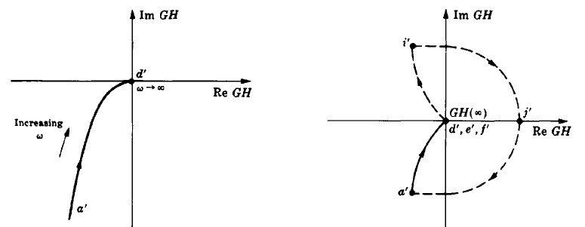
Nyquist or Polar Plot
Nyquist Diagram

Slide 70
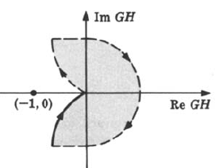
The region to the right of the contour has been shaded.
Clearly, the (-1,0) point is not in the shaded region; therefore it is not enclosed by the contour and so N ≤ 0.
The poles of GH(s) are at s = 0 and s = -1, neither of which are in the right-hand-plane RHP; hence P_{o} = 0. Thus N = -P_{o} = 0, and the system is absolutely stable.

Slide 71
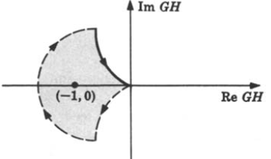
Problem-8: The Nyquist Stability Plot for GH(s) = 1/s(s-1) is given in the figure below.
The region to the right of the contour has been shaded and the (-1,0) point is enclosed; then N > 0. (It is clear that N = 1).
The poles of GH are at s = 0 and s = +1, the latter pole being in the RHP. Hence P_{o} = 1.
N ≠ P_{o} indicates that the system is unstable.
Z = N + P_{o} = 1 + 1 = 2, therefore the poles of the closed-loop transfer function, or the zeros of the characteristic equation 1+GH in the right-hand plane RHP.

